Slide 1


Testing the CAPM
Instructor:
Fall 2019

Slide 2
Overview
Time Series and Cross-Sectional Regressions
CAPM Prediction
Time Series Tests of the CAPM
Cross-Sectional Tests of the CAPM
Discussion

Slide 3
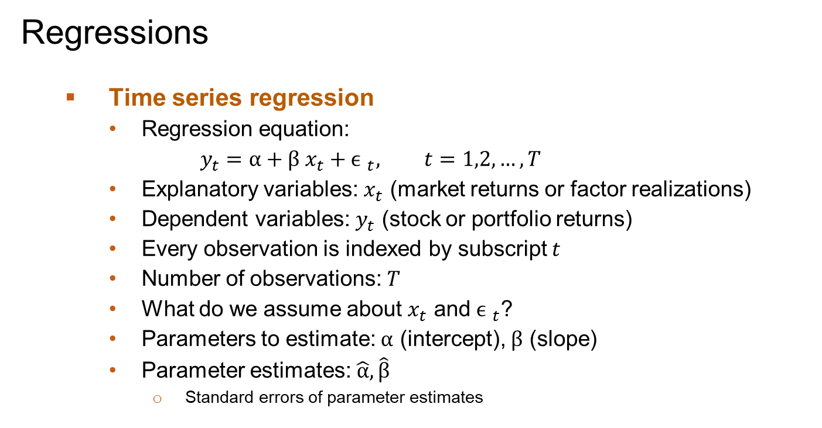
Regressions
Time series regression
Regression equation:
$$y_{t}=α+β x_{t}+{ϵ }_{t}, t=1,2,…,T$$
Explanatory variables: $x_{t}$ (market returns or factor realizations)
Dependent variables: $y_{t}$ (stock or portfolio returns)
Every observation is indexed by subscript $t$
Number of observations: $T$
What do we assume about $x_{t}$ and ${ϵ }_{t}$?
Parameters to estimate: $α$ (intercept), $β$ (slope)
Parameter estimates: $\hat{α},\hat{β}$
Standard errors of parameter estimates

Slide 4
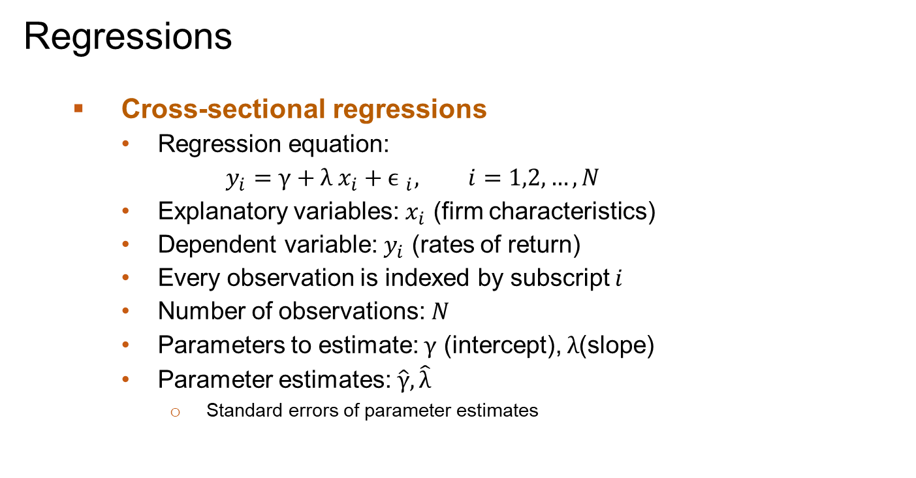
Regressions
Cross-sectional regressions
Regression equation:
$$y_{i}=γ+λ x_{i}+{ϵ }_{i}, i=1,2,…,N$$
Explanatory variables: $x_{i}$ (firm characteristics)
Dependent variable: $y_{i}$ (rates of return)
Every observation is indexed by subscript $i$
Number of observations: $N$
Parameters to estimate: $γ$ (intercept), $λ$(slope)
Parameter estimates: $\hat{γ},\hat{λ}$
Standard errors of parameter estimates

Slide 5
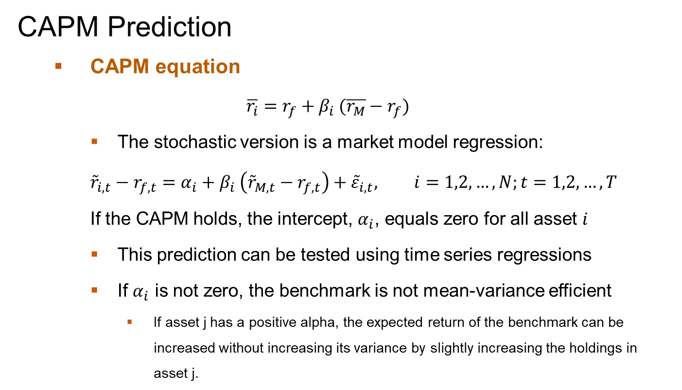
CAPM Prediction
CAPM equation
$$\overline{r_{i}}=r_{f}+β_{i} (\overline{r_{M}}−r_{f})$$
The stochastic version is a market model regression:
$${\tilde{r}}_{i,t}−r_{f,t}=α_{i}+β_{i} \left({\tilde{r}}_{M,t}−r_{f,t}\right)+{\tilde{ε}}_{i,t}, i=1,2,…,N;t=1,2,…,T$$
If the CAPM holds, the intercept, $α_{i}$, equals zero for all asset $i$
This prediction can be tested using time series regressions
If $α_{i}$ is not zero, the benchmark is not mean-variance efficient
If asset j has a positive alpha, the expected return of the benchmark can be increased without increasing its variance by slightly increasing the holdings in asset j.

Slide 6
Time Series Tests of CAPM
Can we test this intercept restriction by estimating regressions on 3000 stocks?
How do we interpret 3000 individual t-tests?
How many alphas are likely to be significantly different than zero by chance?
Are these independent tests?
How does the correlation between individual stock returns influence your interpretation of such tests?

Slide 7
Joint Time Series Tests of CAPM
We can test this hypothesis against “an unspecified alternative” by estimating the market model regression and jointly testing the hypothesis that the alphas all equal zero
This is a joint F-test
It should be noted that this test requires that the number of time series observations (T) exceeds the number of cross-sectional test assets (N)

Slide 8
Some intuition
An individual t-test of the alpha of an individual stock indicates how much the Sharpe ratio of the benchmark can be improved by adding a small amount of the stock to the benchmark – if the t-statistic is significant, it means that the Sharpe ratio is increased by a significant amount
The F-statistic is essentially the ratio of the maximum Sharpe ratio that can be achieved from the test assets to the Sharpe ratio of the benchmark. If the F-statistic is high, then the maximal Sharpe ratio is significantly higher than the benchmark Sharpe ratio
Why does the test require that T>N?
When T<N, the maximal Sharpe ratio of the test assets is infinite

Slide 9
Forming Portfolios
Because of the restriction that N<T, we must form portfolios to test the CAPM
We can do this by either forming industry portfolios or what we will refer to as characteristic-sorted portfolios
I prefer forming value-weighted portfolios. However, we often see equally-weighted portfolios in both industry and academic presentations

Slide 10
Equally Weighted versus Value Weighted portfolios
ME-sorted decile portfolios from French's website
Sample period: 1963m7-2018m12

Slide 11
Time Series Tests of CAPM: industry portfolios
Using Fama and French 10 and 49 industry portfolios as test assets
Monthly portfolio returns, risk free rates and market portfolio returns from French’s website
Notes:
The R squares are higher for the 10 FF industries because the portfolios are more diversified.

Slide 12
Equally Weighted versus Value Weighted portfolios
ME-sorted decile portfolios from French's website
Sample period: 1963m7-2018m12

Slide 13
Time Series Tests of CAPM
We say that a test has more power if it is more likely to reject the null hypothesis when the null is in fact wrong
The trick to finding a more powerful test is to have a hypothesis that better describes why the theory is likely to be wrong and to form portfolios based on that theory
However, this process of searching for alternatives that reject the CAPM creates inherent data mining biases

Slide 14
Time Series Tests of CAPM
Perhaps, the most intuitive alternative hypothesis is that returns are not related to betas
If this is the case, then high beta portfolios will have negative alphas and low beta portfolios will have positive alphas
We can test this hypothesis by forming portfolios based on past betas

Slide 15
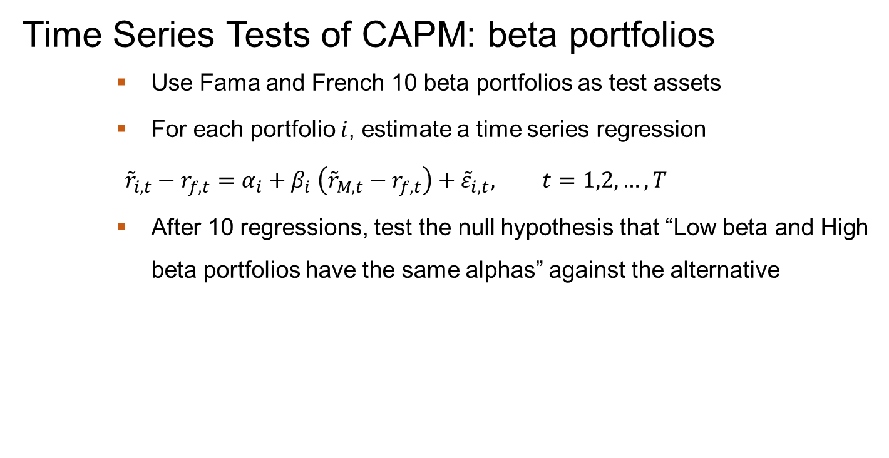
Time Series Tests of CAPM: beta portfolios
Use Fama and French 10 beta portfolios as test assets
For each portfolio $i$, estimate a time series regression
$${\tilde{r}}_{i,t}−r_{f,t}=α_{i}+β_{i} \left({\tilde{r}}_{M,t}−r_{f,t}\right)+{\tilde{ε}}_{i,t}, t=1,2,…,T$$
After 10 regressions, test the null hypothesis that “Low beta and High beta portfolios have the same alphas” against the alternative

Slide 16
Time Series Tests of the CAPM
Another alternative hypothesis is that returns are related to characteristics that may be associated with potentially priced risks that are not captured by betas
Popular characteristics that have been used in the past include, market capitalization, book to market ratios, and various past return measures
When we form portfolios based on these characteristics, we can perform the same joint F-tests that we performed on industry portfolios
But we might be able to do better,
under the alternative, the zero-cost portfolio that consists of buying the portfolio with the most favorable characteristic and selling the portfolio with the least favorable characteristic generates the highest return
A simple t-test of the significance of the alpha of that zero-cost portfolio may provide a more powerful test

Slide 17
Time Series Tests of CAPM: Size and BE/ME sorted Portfolios

Slide 18
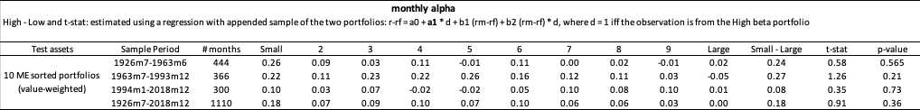
Time Series Tests of CAPM: size portfolios
Use Fama and French 10 ME sorted portfolios as test assets
Monthly portfolio returns, risk free rates and market portfolio returns from French’s website

Slide 19
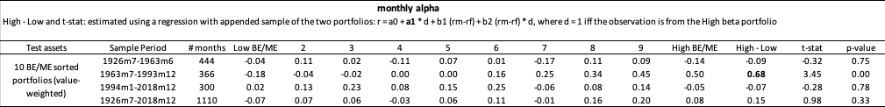
Time Series Tests of CAPM: value portfolios
Use Fama and French 10 BE/ME sorted portfolios as test assets
Monthly portfolio returns, risk free rates and market portfolio returns from French’s website

Slide 20
Double Sorts
The relation between returns and most characteristics is stronger for small stocks
Perhaps, reflects the possibility that large stocks are more efficiently priced
Explains why we see stronger evidence with equally weighted test portfolios
To get a more complete picture of the relation between characteristics and returns one should perform double sorts

Slide 21
Time Series Tests of CAPM: size-by-value portfolios
Use Fama and French ME and BE/ME sorted portfolios as test assets: 5 * 5 = 25 portfolios

Slide 22
Time Series Tests of CAPM: size-by-value portfolios
Use Fama and French ME and BE/ME sorted portfolios as test assets: 5 * 5 = 25 portfolios

Slide 23
Time Series Tests of CAPM: size-by-value portfolios
Use Fama and French ME and BE/ME sorted portfolios as test assets: 5 * 5 = 25 portfolios

Slide 24
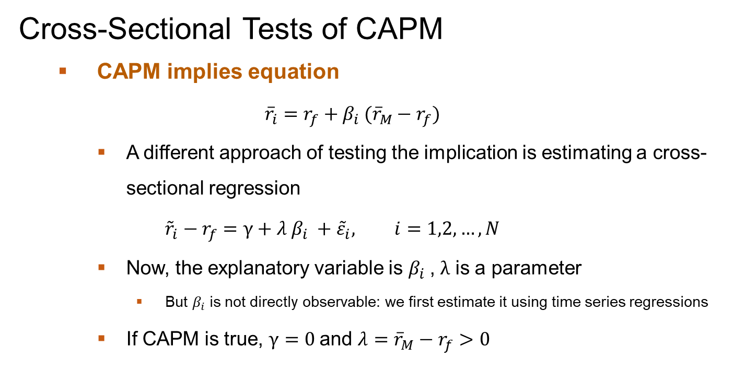
Cross-Sectional Tests of CAPM
CAPM implies equation
$${\overline{r}}_{i}=r_{f}+β_{i} ({\overline{r}}_{M}−r_{f})$$
A different approach of testing the implication is estimating a cross-sectional regression
$${\tilde{r}}_{i}−r_{f}=γ+λ β_{i} +{\tilde{ε}}_{i}, i=1,2,…,N$$
Now, the explanatory variable is $β_{i}$, $λ$ is a parameter
But $β_{i}$ is not directly observable: we first estimate it using time series regressions
If CAPM is true, $γ=0$and $λ={\overline{r}}_{M}−r_{f}>0$

Slide 25
Cross-Sectional Tests of the CAPM
Researchers often want to examine the link between the returns and a number of characteristics simultaneously.
Intuitively, we would like to do a cross-sectional multiple regression of individual stock returns on firm characteristics, like size, book to market, earnings growth, etc.
We can estimate such a regression but calculating the t-statistics for this regression presents some challenges
If the number of time series observations exceeds the number of cross-sectional observations, we can use a standard GLS panel regression procedure to estimate the regression
However, in most applications, we consider about 3000 stocks and at most 50 years of monthly data, so 600 months – so the GLS regression will not work

Slide 26
Fama-MacBeth regression
We estimate the cross-sectional regression of returns on characteristics in each month and calculate their means
The time series standard deviation of these coefficients can be used to estimate the standard errors of these means
Under the null hypothesis that returns are serially uncorrelated (which is not a bad assumption) this provides an appropriate test statistic.
The time series of the FM coefficient estimates are analogous to the returns of portfolios that are formed based on coefficients.
Indeed, some hedge funds use this technique to form portfolios.
So we are essentially estimating the mean and standard deviation of characteristics-based portfolios using this approach.

Slide 27
Cross-Sectional Tests of CAPM: FM regression
Results:
Notes:
Note, the FM regression coefficients are a lot like equally weighted portfolios – they are rebalanced monthly. We have added the last month return to illustrate how strong the monthly reversal has been historically.

Slide 28
Cross-Sectional Tests of CAPM: FM regression
Results:

Slide 29
Cross-Sectional Tests of CAPM: FM regression
Results:

Slide 30
Tests of CAPM: Discussion
These tests all seem to reject the CAPM – put somewhat differently, the tests indicate that the value-weighted portfolio is not mean-variance efficient
This creates a problem for corporate finance people that want to use the CAPM to estimate cost of capital. I’m not convinced that there is a lot that can be done to deal with this problem.
This also creates a problem for people who want to use the CAPM to evaluate the performance of managed portfolios. We can deal with this problem with multi-factor models.

Slide 31
Tests of CAPM: Discussion
The actual portfolio that we use as the market portfolio in tests of the CAPM is actually somewhat arbitrary. In this sense, it’s not surprising that our tests reject the CAPM.
However, the tests are not vacuous – the tests indicate that applications of the CAPM, which do use these benchmarks, may be somewhat misguided
Such as cost of capital applications
Portfolio performance evaluation

Slide 32
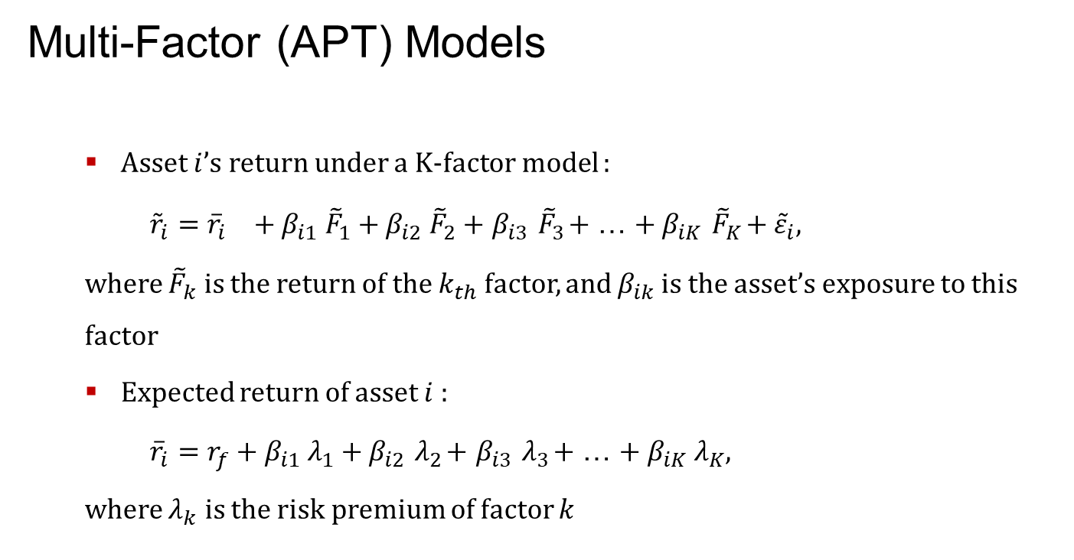
Multi-Factor (APT) Models
Asset $i$’s return under a K-factor model :
${\tilde{r}}_{i}={{\overline{r}}_{i}}_{}+β_{i1} {\tilde{F}}_{1}+β_{i2} {\tilde{F}}_{2}+$ $β_{i3}{ \tilde{F}}_{3}+$ … ${+ β}_{iK}{ \tilde{F}}_{K}+{\tilde{ε}}_{i}$,
where ${\tilde{F}}_{k}$ is the return of the $k_{th}$ factor, and $β_{ik}$ is the asset’s exposure to this factor
Expected return of asset $i$ :
${\overline{r}}_{i}=r_{f}+β_{i1} λ_{1}+β_{i2}{ λ}_{2}+$ $β_{i3}{ λ}_{3}+$ … ${+ β}_{iK} λ_{K}$,
where $λ_{k}$ is the risk premium of factor $k$

Slide 33
Some Useful Observations
If we start with an inefficient single (market) benchmark and include a second factor portfolio that is not too highly correlated with the benchmark, then the combination of the two factor portfolios should plot above the initial benchmark in mean-variance space.
If we have K factor portfolios that can be combined to form a mean-variance efficient portfolio, then if we regress the return premia of individual assets on the returns of this set of factor portfolios their estimated alphas will be zero
If the systematic risk of all assets can be described by the returns of K factors, then in the absence of arbitrage, any set of K diversified portfolios that are not too highly correlated can be combined to form the mean-variance efficient portfolio.

Slide 34
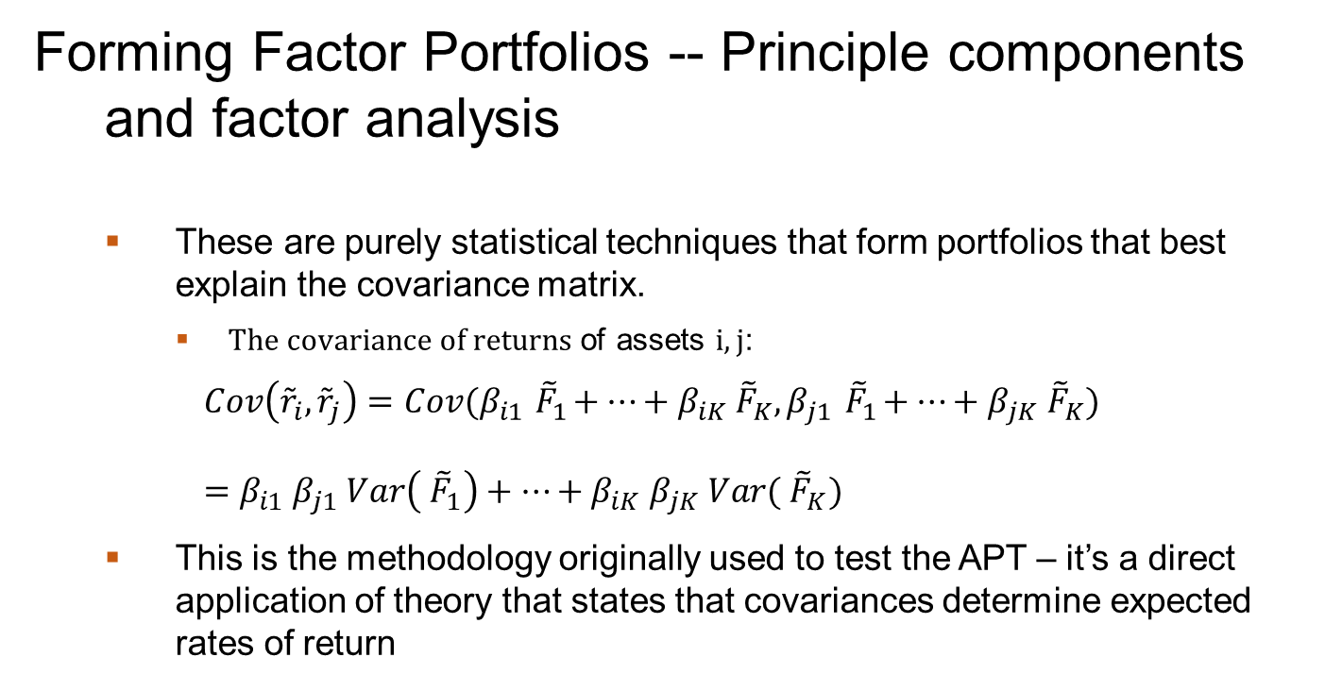
Forming Factor Portfolios -- Principle components and factor analysis
These are purely statistical techniques that form portfolios that best explain the covariance matrix.
$The covariance of returns$ of assets $i,j$:
$$Cov\left({\tilde{r}}_{i},{\tilde{r}}_{j}\right)={Cov(β}_{i1}{ \tilde{F}}_{1}+…+β_{iK}{ \tilde{F}}_{K},β_{j1}{ \tilde{F}}_{1}+…+β_{jK}{ \tilde{F}}_{K})$$
$=$ $β_{i1}{ β}_{j1} Var\left({ \tilde{F}}_{1}\right)+…+β_{iK}{ β}_{jK} Var({ \tilde{F}}_{K})$
This is the methodology originally used to test the APT – it’s a direct application of theory that states that covariances determine expected rates of return

Slide 35
Forming Factor Portfolios -- Principle component analysis example
Data: Fama and French industry portfolios
Procedure
Step 1: use PCA to generate eigenvectors of the covariance matrix
Step 2: transform original portfolio returns into statistical factors using the eigenvectors and return standard deviations
Step 3: keep the returns corresponding to the first three principal components
Step 4: use these three returns as test assets and run GRS F test

Slide 36
Forming Factor Portfolios -- Principle component analysis example
Results

Slide 37
Forming Factor Portfolios -- Principle component analysis example
Results

Slide 38
Forming Factor Portfolios – Macro Factors
Changes in GDP, inflation, unemployment, interest rates, etc.
The idea is to identify the macro factors that should in theory explain returns and then form factor portfolios that tend to move with these macro variables
This is straightforward for interest rate factors, e.g., term spreads and credit spreads
For macro factors like GNP, inflation, unemployment, we need unanticipated changes, which is more difficult
I’m not aware of any recent industry or academic applications so we will skip this approach (at least for now)

Slide 39
Forming Factor Portfolios – Characteristic-sorted Portfolios
Characteristic-based factors – form portfolios based on characteristics that tend to explain returns
If there is a relation between characteristics and systematic risk factors then diversified portfolios of characteristic-sorted portfolios should be good proxies for the factors
This, in part, is the motivation behind the “smart beta” portfolios
Since we tend to select the characteristics based on historical rates of return, we can’t really use these factor portfolios to test the theory
However, if portfolio managers tend to form portfolios based on these characteristics, they provide good benchmarks for evaluating the managed portfolios

Slide 40
Mutual fund performance: A Useful Application
Use actively managed equity mutual funds as test assets
133 large funds with at least $4 billion AUM as of Jan, 1998
Monthly after-fee fund returns
Missing fund returns (of deceased funds) are filled with market returns
Sample period: 1998m1-2018m12
Benchmarks
Fama and French 3 factors
First three "statistical factors" based on 49 industry portfolios

Slide 41
Mutual fund performance
Results

